Slide 1
Data and Signals

Slide 2
Topics of Discussion
Data and Signals
- Analog and Digital Signals
- Periodic and Non Periodic Signals
Periodic Analog Signals
- Sine Wave
- Amplitude , Frequency, Phase
-Wavelength
- Time domain and Frequency Domain
- Composite Signals
- Bandwidth
Digital Signals
- Bit rate
Notes:
1.#

Slide 3
Analog and Digital Data
Data can be analog or digital. The term analog data refers to information that is continuous;
Digital data refers to information that has discrete states.
Like the data they represent, signals can be either analog or digital. An analog signal has infinitely many levels of intensity over a period of time. As the wave moves from value A to value B, it passes through and includes an infinite number of values along its path.
A digital signal, on the other hand, can have only a limited number of defined values. Although each value can be any number, it is often as simple as 1 and 0.
Analog and Digital Signals
Notes:
1.#

Slide 4
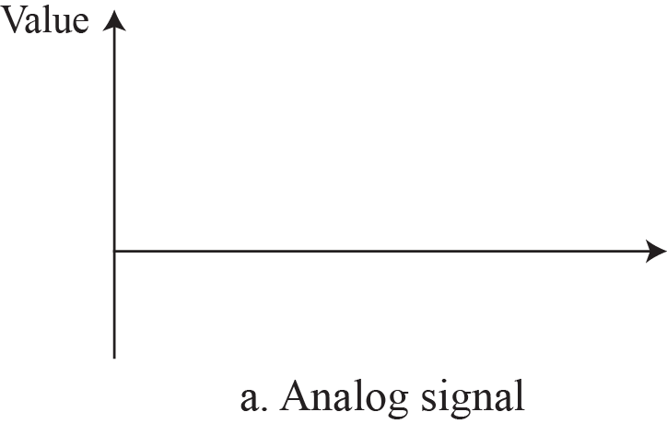

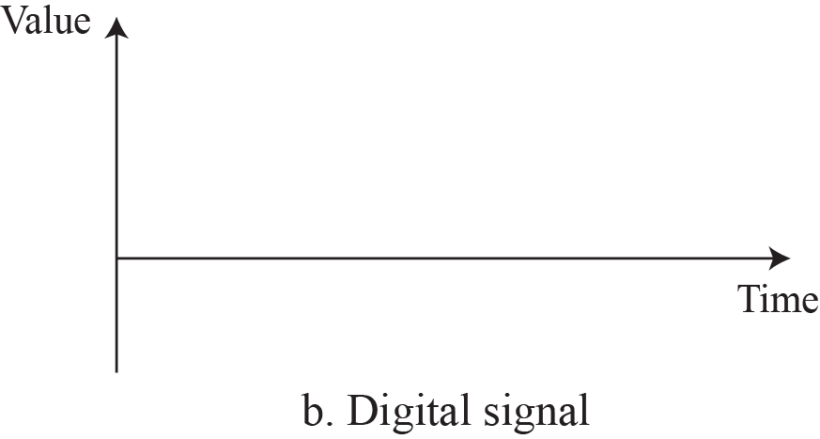

Figure 1: Comparison of analog and digital signals
Notes:
1.#

Slide 5
Periodic and Nonperiodic
  A periodic signal completes a pattern within a measurable time frame, called a period, and repeats that pattern over subsequent identical periods. The completion of one full pattern is called a cycle.
  A nonperiodic signal changes without exhibiting a pattern or cycle that repeats over time.
  Periodic Analog Signals
  Periodic analog signals can be classified as simple or composite. A simple periodic analog signal, a sine wave, cannot be decomposed into simpler signals.
  A composite periodic analog signal is composed of multiple sine waves.
Notes:
1.#

Slide 6
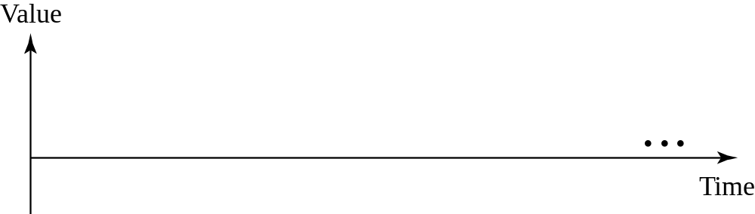

Sine Wave
The sine wave is the most fundamental form of a periodic analog signal. When we visualize it as a simple oscillating curve, its change over the course of a cycle is smooth and consistent, a continuous, rolling flow.
Figure 2: A sine wave
Notes:
1.#

Slide 7
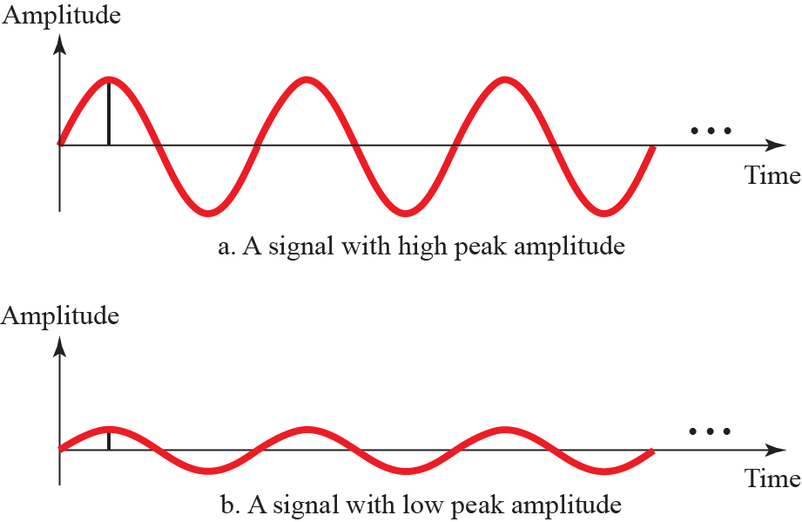

Figure 3: Two signals with two different amplitudes
Notes:
1.#

Slide 8
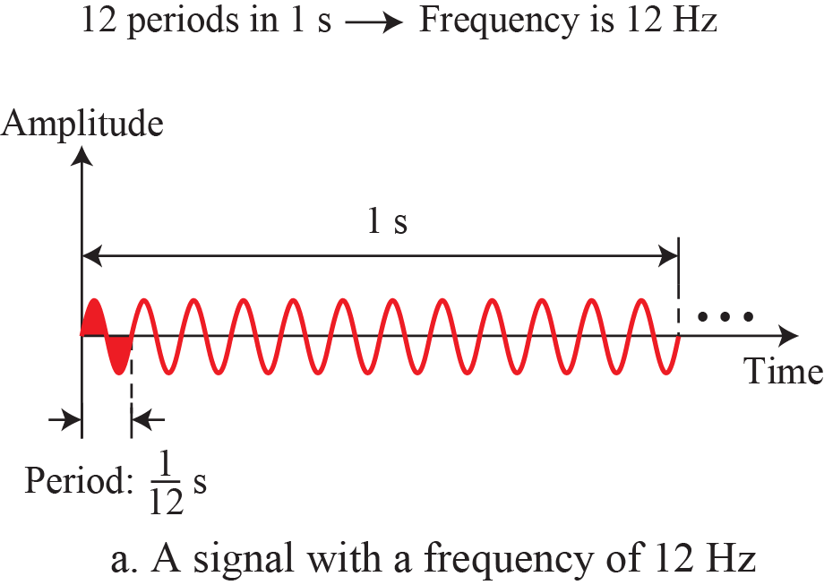
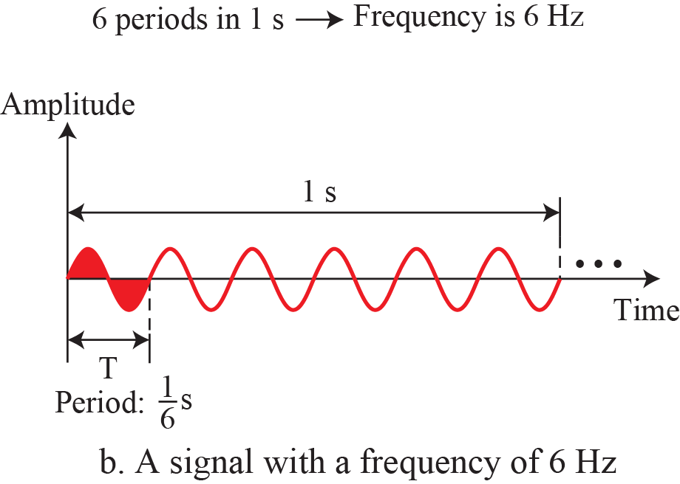
Figure 4: Two signals with the same phase and amplitude, but different frequency
Notes:
1.#

Slide 9
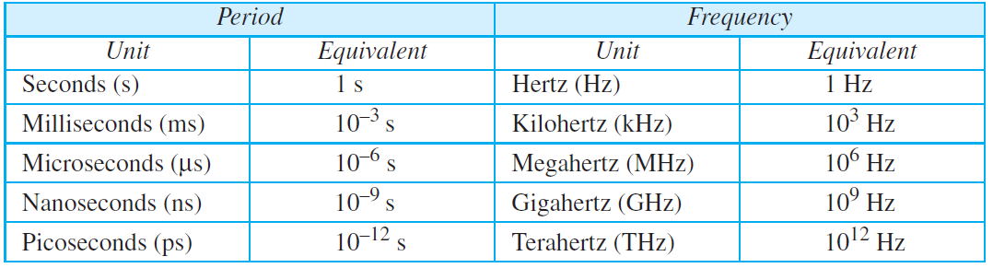
Table 1: Units of period and frequency

Slide 10
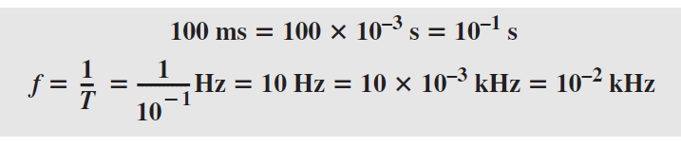
Example 1: Express a period of 100 ms in microseconds
Example 2: The period of a signal is 100 ms. What is its frequency in kilohertz?.

Slide 11
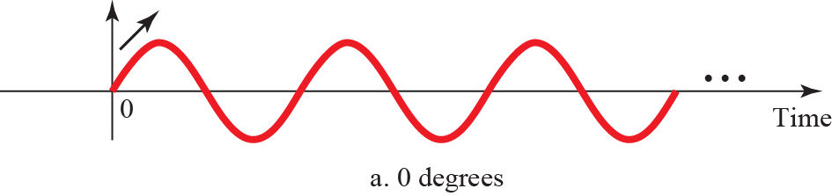
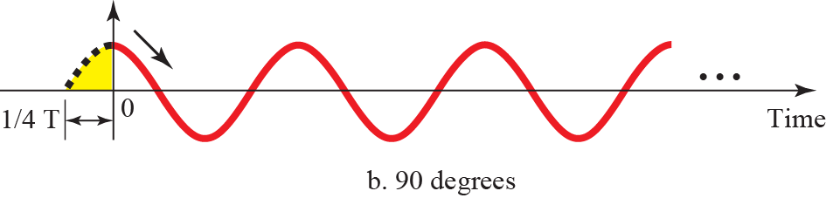
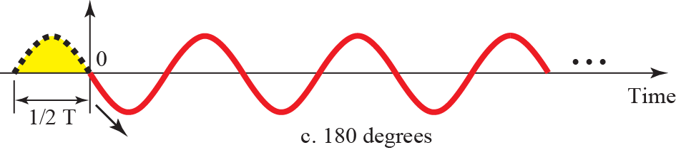
Phase
The term phase, or phase shift, describes the position of the waveform relative to time 0. If we think of the wave as something that can be shifted backward or forward along the time axis, phase describes the amount of that shift. It indicates the status of the first cycle.
Figure 5: Three sine waves with different phases
Notes:
1.#

Slide 12


Wavelength
Wavelength is another characteristic of a signal traveling through a transmission medium. Wavelength binds the period or the frequency of a simple sine wave to the propagation speed of the medium .
Figure 6: Wavelength and period
Notes:
1.#

Slide 13
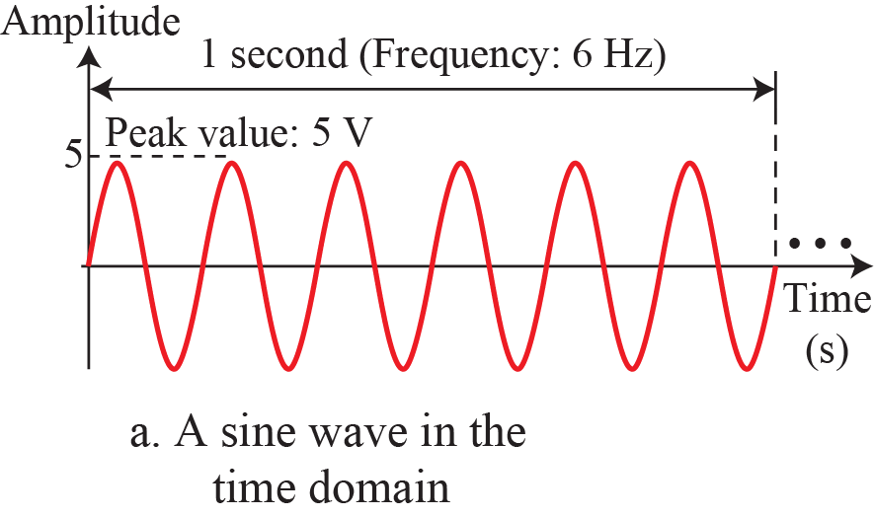
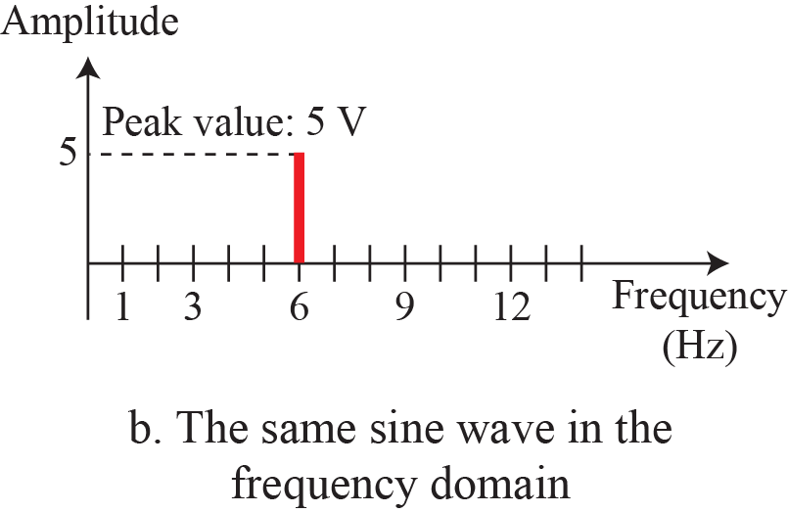
Time and Frequency Domains
A sine wave is comprehensively defined by its amplitude, frequency, and phase. We have been showing a sine wave by using what is called a time domain plot. The time-domain plot shows changes in signal amplitude with respect to time (it is an amplitude-versus-time plot).
Figure 7: The time-domain and frequency-domain plots of a sine wave
Notes:
1.#

Slide 14
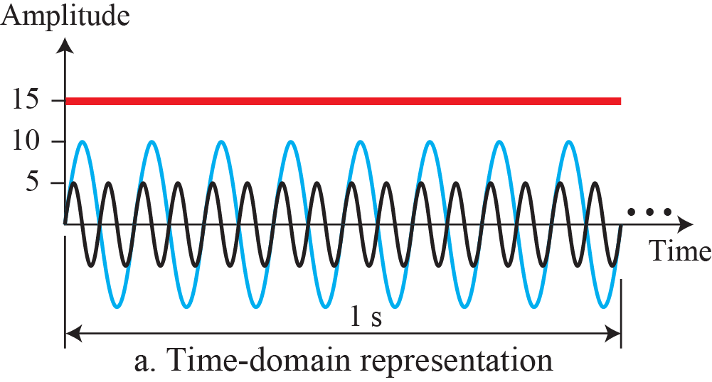
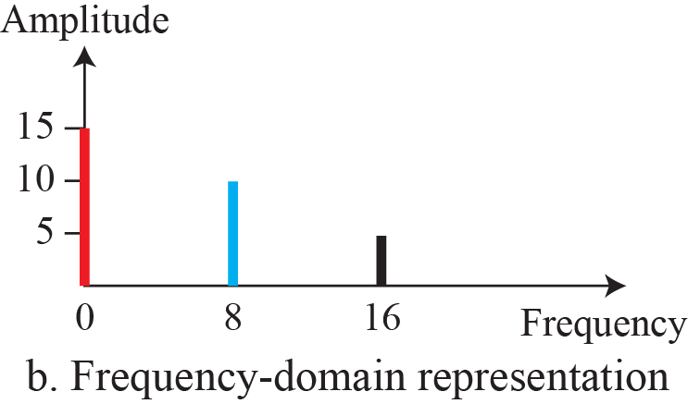
Example
The frequency domain is more compact and useful when we are dealing with more than one sine wave. Figure 8 shows three sine waves, each with different amplitude and frequency. All can be represented by three spikes in the frequency domain.
Figure 8: The time domain and frequency domain of three sine waves
Notes:
1.#

Slide 15
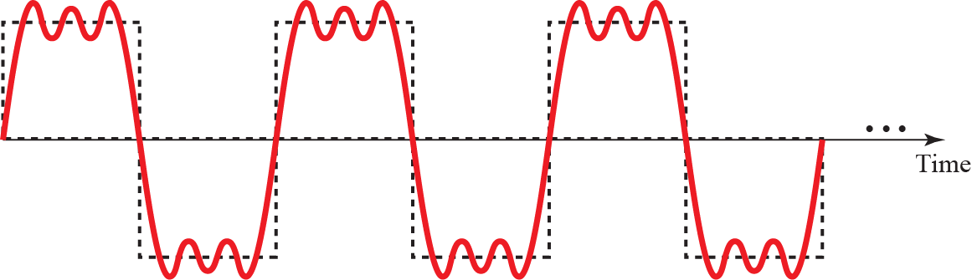
Composite Signals
Figure 9: A composite periodic signal
Notes:
1.#

Slide 16
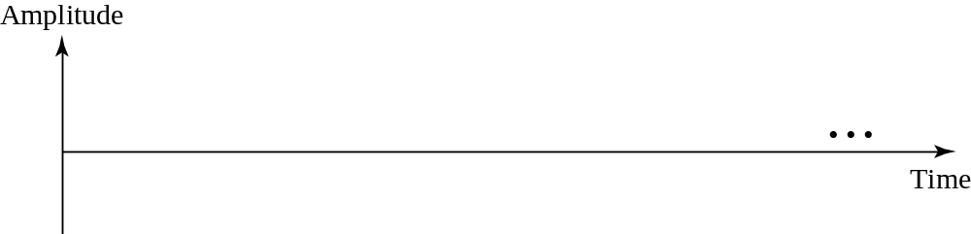

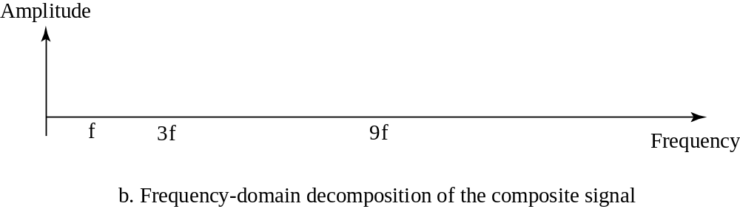
Decomposition of a composite periodic signal
a. Time –Domain decomposition of the composite signal
Notes:
1.#

Slide 17
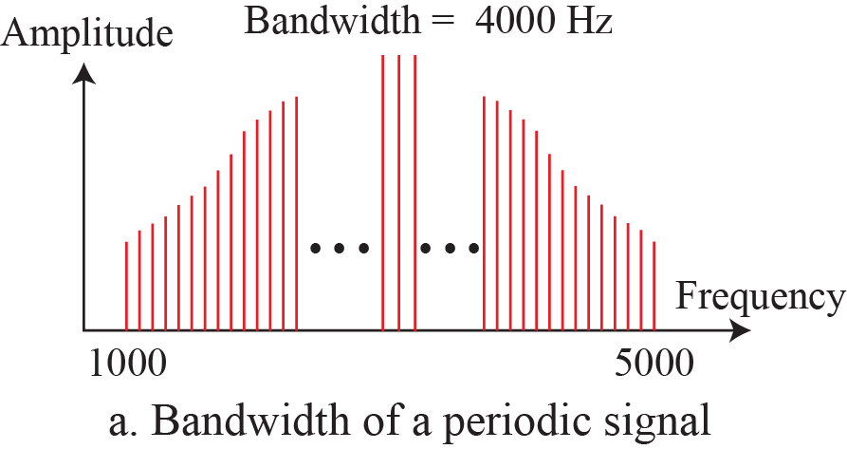
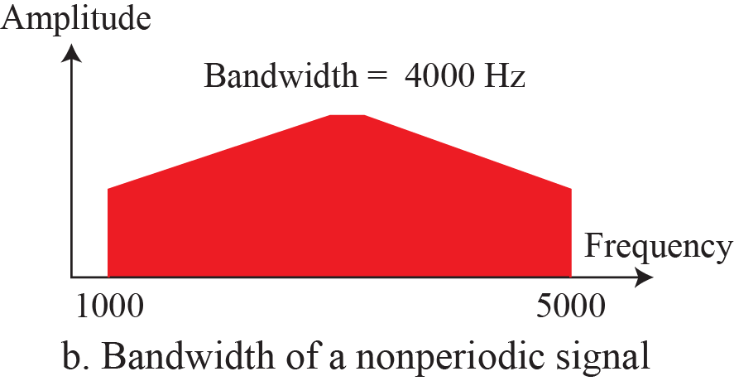
Bandwidth
The range of frequencies contained in a composite signal is its bandwidth. The bandwidth is normally a difference between two numbers. For example, if a composite signal contains frequencies between 1000 and 5000, its bandwidth is 5000 − 1000, or 4000
Figure 10: The bandwidth of periodic and nonperiodic composite signals
Notes:
1.#

Slide 18

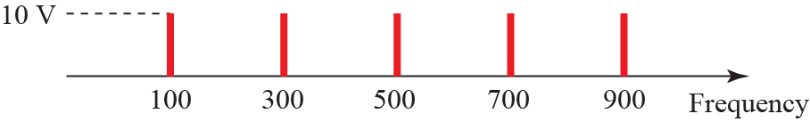

Example 1: If a periodic signal is decomposed into five sine waves with frequencies of 100, 300, 500, 700, and 900 Hz, what is its bandwidth? Draw the spectrum, assuming all components have a maximum amplitude of 10 V.
Solution: Let f_{h} be the highest frequency, f_{l} the lowest frequency, and B the bandwidth. Then

Slide 19
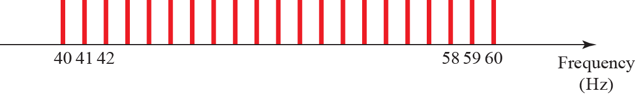
Example 2: A periodic signal has a bandwidth of 20 Hz. The highest frequency is 60 Hz. What is the lowest frequency? Draw the spectrum if the signal contains all frequencies of the same amplitude.
Solution: Let f_{h} be the highest frequency, f_{l} the lowest frequency, and B the bandwidth. Then
The spectrum contains all integer frequencies. We show this by a series of spikes.
Figure 11: The bandwidth for example 3.11
Notes:
1.#

Slide 20
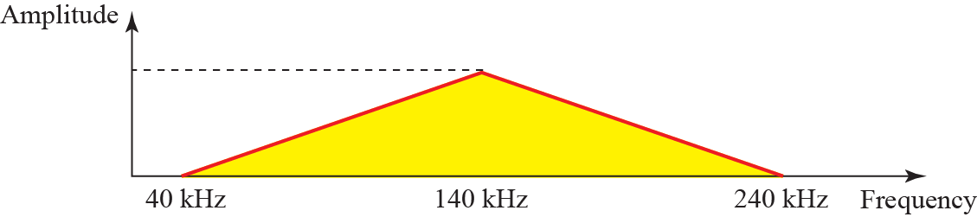
Example : A non-periodic composite signal has a bandwidth of 200 kHz, with a middle frequency of 140 kHz and peak amplitude of 20 V. The two extreme frequencies have an amplitude of 0. Draw the frequency domain of the signal
Notes:
1.#

Slide 21
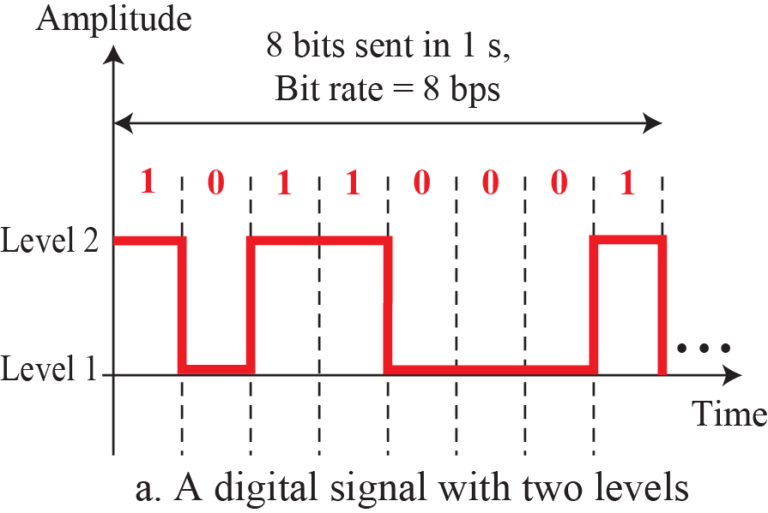
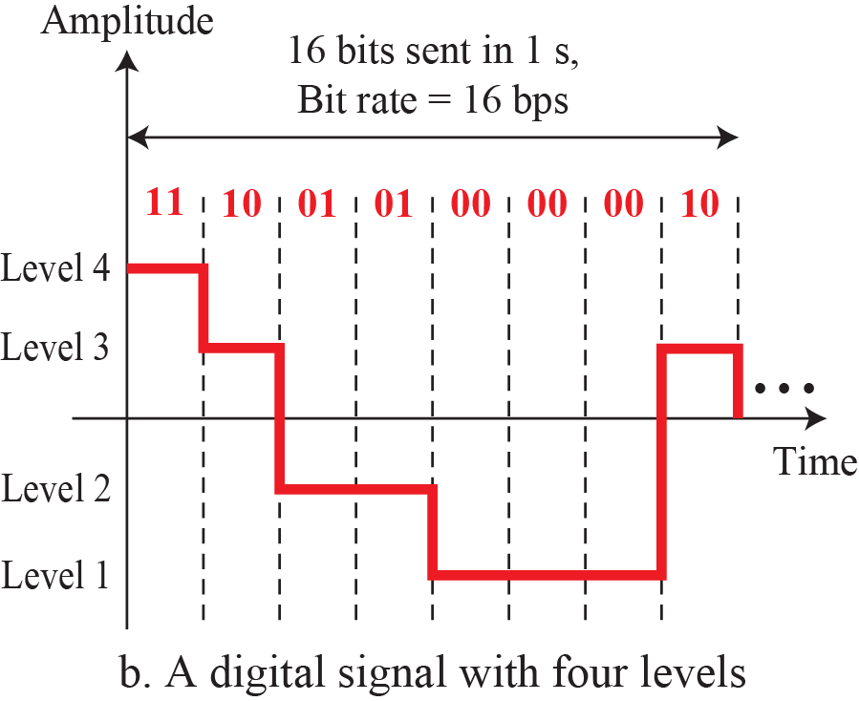
Digital Signals
In addition to being represented by an analog signal, information can also be represented by a digital signal. For example, a 1 can be encoded as a positive voltage and a 0 as zero voltage. A digital signal can have more than two levels. In this case, we can send more than 1 bit for each level.
Figure 12: Two digital signals: one with two signal levels and the 0ther with four signal levels
Notes:
1.#

Slide 22
Bit Rate
Most digital signals are nonperiodic, and thus period and frequency are not appropriate characteristics. Another term—bit rate (instead of frequency)—is used to describe digital signals. The bit rate is the number of bits sent in 1s, expressed in bits per second (bps).
Notes:
1.#

Slide 23
Example: What is the bit rate for high-definition TV (HDTV)?
HDTV uses digital signals to broadcast high quality video signals. There are 1920 by 1080 pixels per screen, and the screen is renewed 30 times per second. Twenty-four bits represents one color pixel. We can calculate the bit rate as
The TV stations reduce this rate to 20 to 40 Mbps through compression.
Notes:
1.#

Slide 24
Summary of Discussion
In this session we have mainly discussed:
Data and Signals
Periodic analog signals
Digital signals
Notes:
1.#

Slide 25

Notes:
1.#

